Slide 1
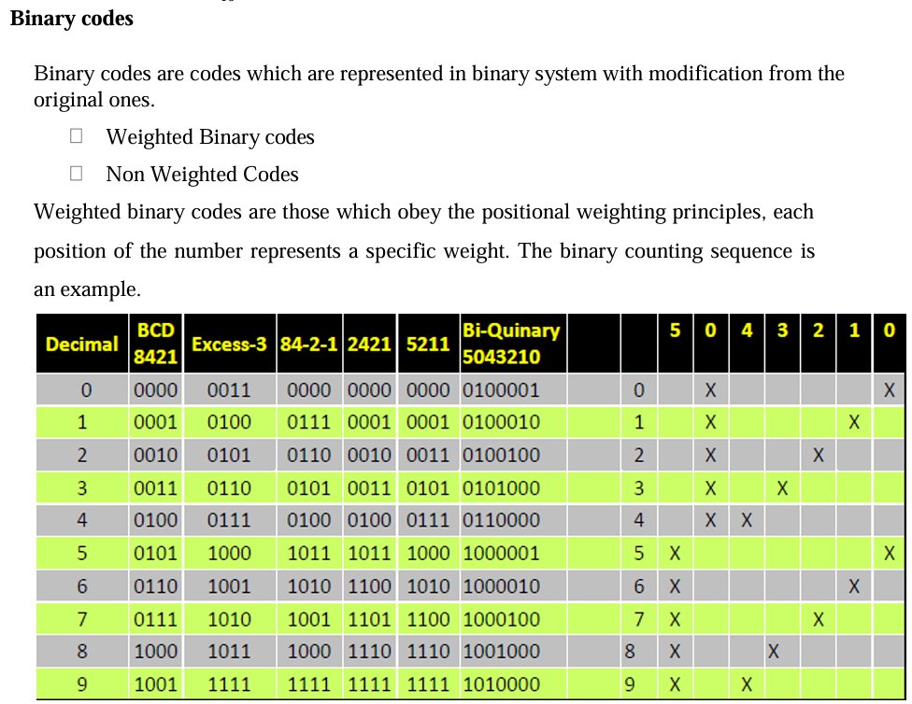

Slide 2
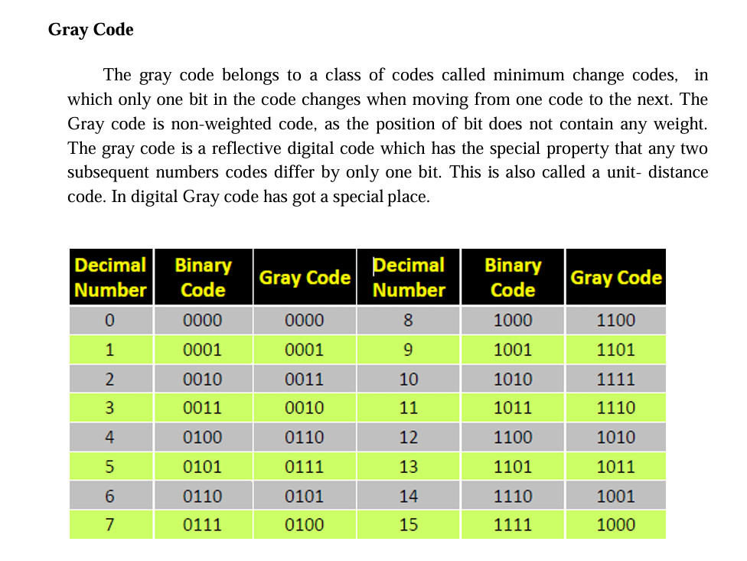

Slide 3
Reflective Code
A code is said to be reflective when code for 9 is complement for the code for 0, and so is for 8 and 1 codes, 7 and 2, 6 and 3, 5 and 4. Codes 2421, 5211, and excess-3 are reflective, whereas the 8421 code is not.

Slide 4
Sequential Codes
A code is said to be sequential when two subsequent codes, seen as numbers in binary representation, differ by one. This greatly aids mathematical manipulation of data. The 8421 and Excess-3 codes are sequential, whereas the 2421 and 5211 codes are not.

Slide 5
Non weighted codes
Non weighted codes are codes that are not positionally weighted. That is, each position within the binary number is not assigned a fixed value. Ex: Excess-3 code
Excess-3 Code
Excess-3 is a non weighted code used to express decimal numbers. The code derives its name from the fact that each binary code is the corresponding 8421 code plus 0011(3).

Slide 6
Complements:
In digital computers to simplify the subtraction operation & for logical manipulation complements are used. There are two types of complements used in each radix system.
i) The radix complement or r’s complement
ii) The diminished radix complement or (r-1)’s complement

Slide 7
Representation of signed no.s binary arithmetic in computers: • Two ways of rep signed no.s
Sign Magnitude form
2. Complemented form
• Two complimented forms
1‘s compliment form
2. 2‘s compliment form
Advantage of performing subtraction by the compliment method is reduction in the hardware.( instead of addition & subtraction only adding circuit‘s are needed.) i. e, subtraction is also performed by adders only.

Slide 8
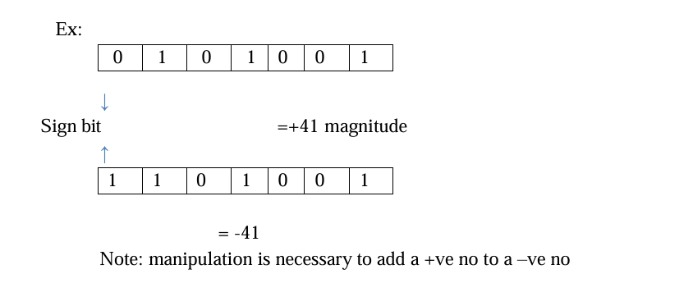
Instead of subtracting one no. from other the compliment of the subtrahend is added to minuend. In sign magnitude form, an additional bit called the sign bit is placed in front of the no. If the sign bit is 0, the no. is +ve, If it is a 1, the no is _ve.

Slide 9
1’s Complement Arithmetic
Steps:
Convert the given numbers in 1’s complement form.
ADD them.
Carry: Add to the result (at the end)
No carry.
MSB , If 0 …check result is +ve ….pure binary form
If 1, result is negative
Result is 1’s complement

Slide 10
2’s Complement Arithmetic
Steps:
Convert the given numbers in 2’s complement form.
ADD them.
if Carry neglect them
Check MSB , If 0 …check result is +ve ….pure binary form
If 1, result is negative
Result is 2’s complement

